Slide 1
Three-Dimensional Fluid Motion in Faraday Waves
Creation of Vorticity and Generation of Two-Dimensional Turbulence

Slide 2
2D Turbulence Model of FW

Slide 3
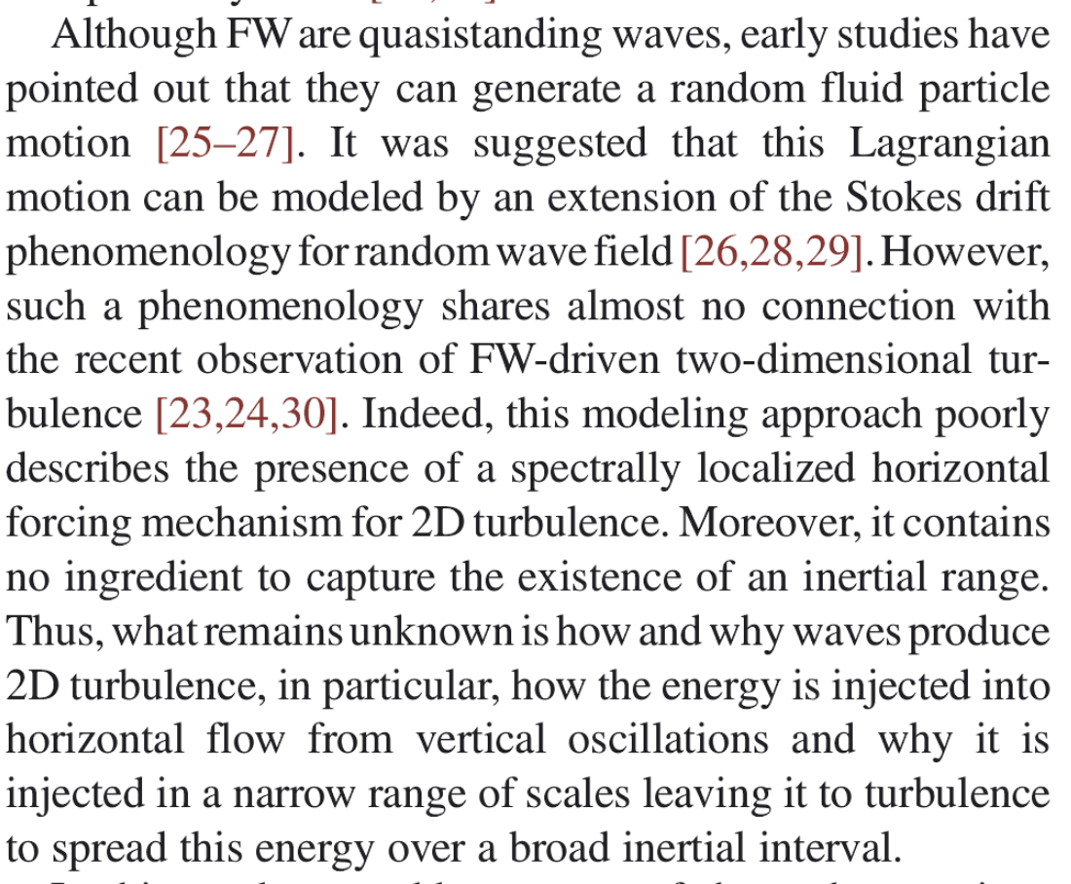
Proofs and Problems
1spectrally localized forcing
2existience of inertial range
1vertical to horizontal
2broad inertial range

Slide 4
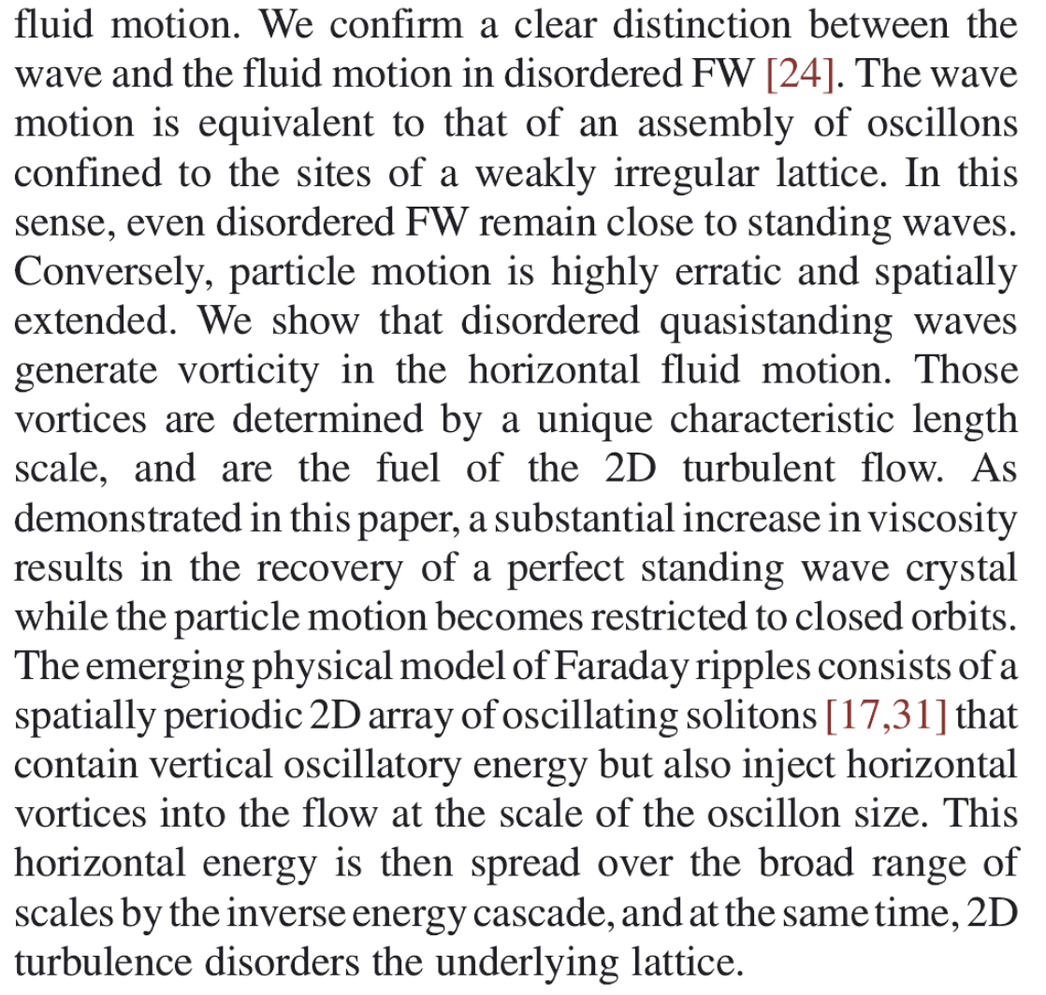
Some results
wave disorder vs partical disorder
wave disorder generates vortices
----from wave crystal experiment
lattice-turbulence interaction

Slide 5
Lagrangian Trajectories Analysis

Slide 6
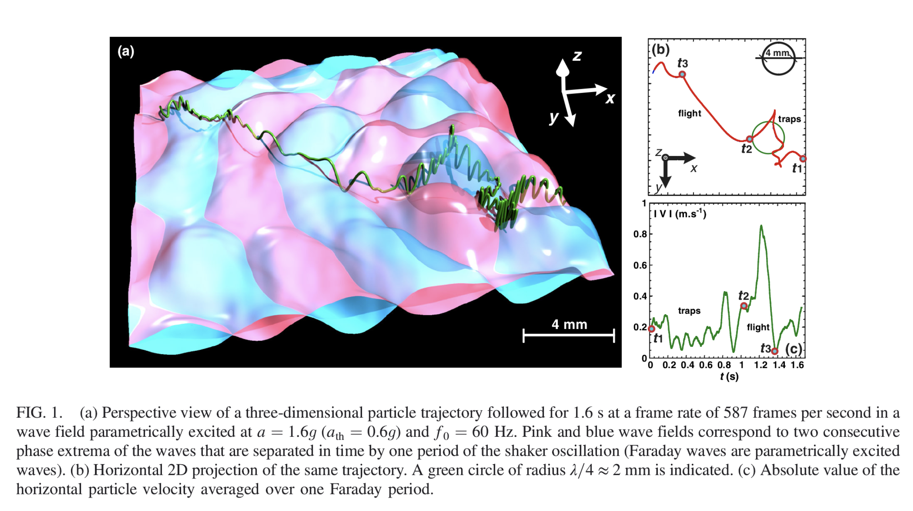
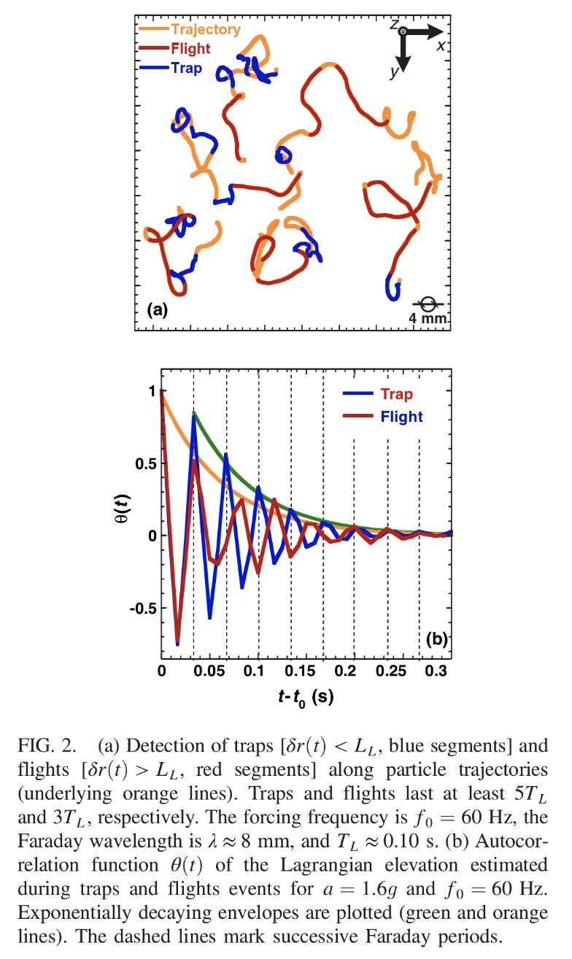
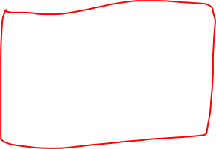
Traps and Flights
the trajectory disproved Stokes
correlation time/scale
define and compute T/F
autocorrelation function
decay time
peaks

Slide 7
Study of 2D Turbulence

Slide 8
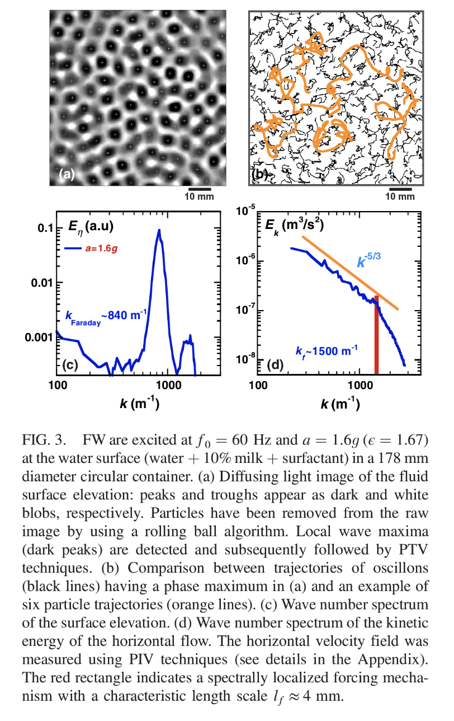
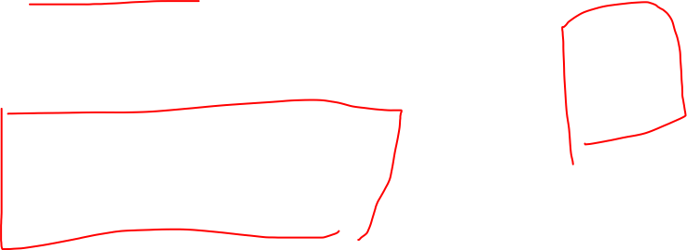
Wave disorder
peak tracking
oscillon motion vs particle motion
different scale
(d)Study the connection between
horizontal motion and velocity
----use Eulerian frame
wave number spectrum-Kolmogorov
homogeneous -> incompressible

Slide 9
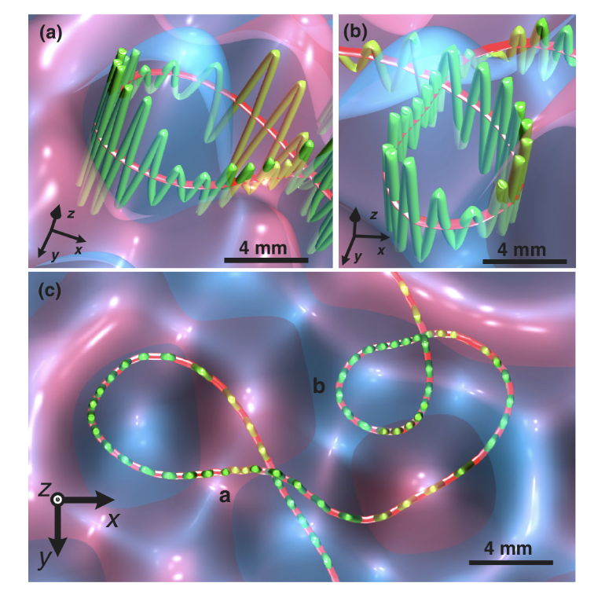
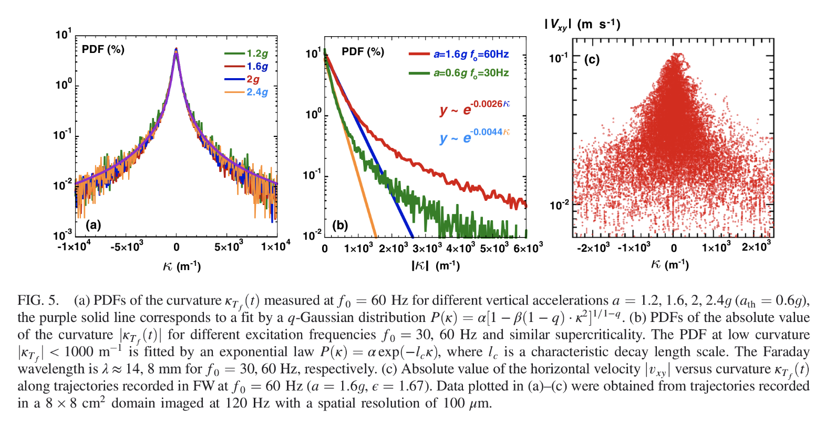
Curvature Study
change in frequency
geometry -> curvature
computing method
PDF analysis
connection with velocity

Slide 10
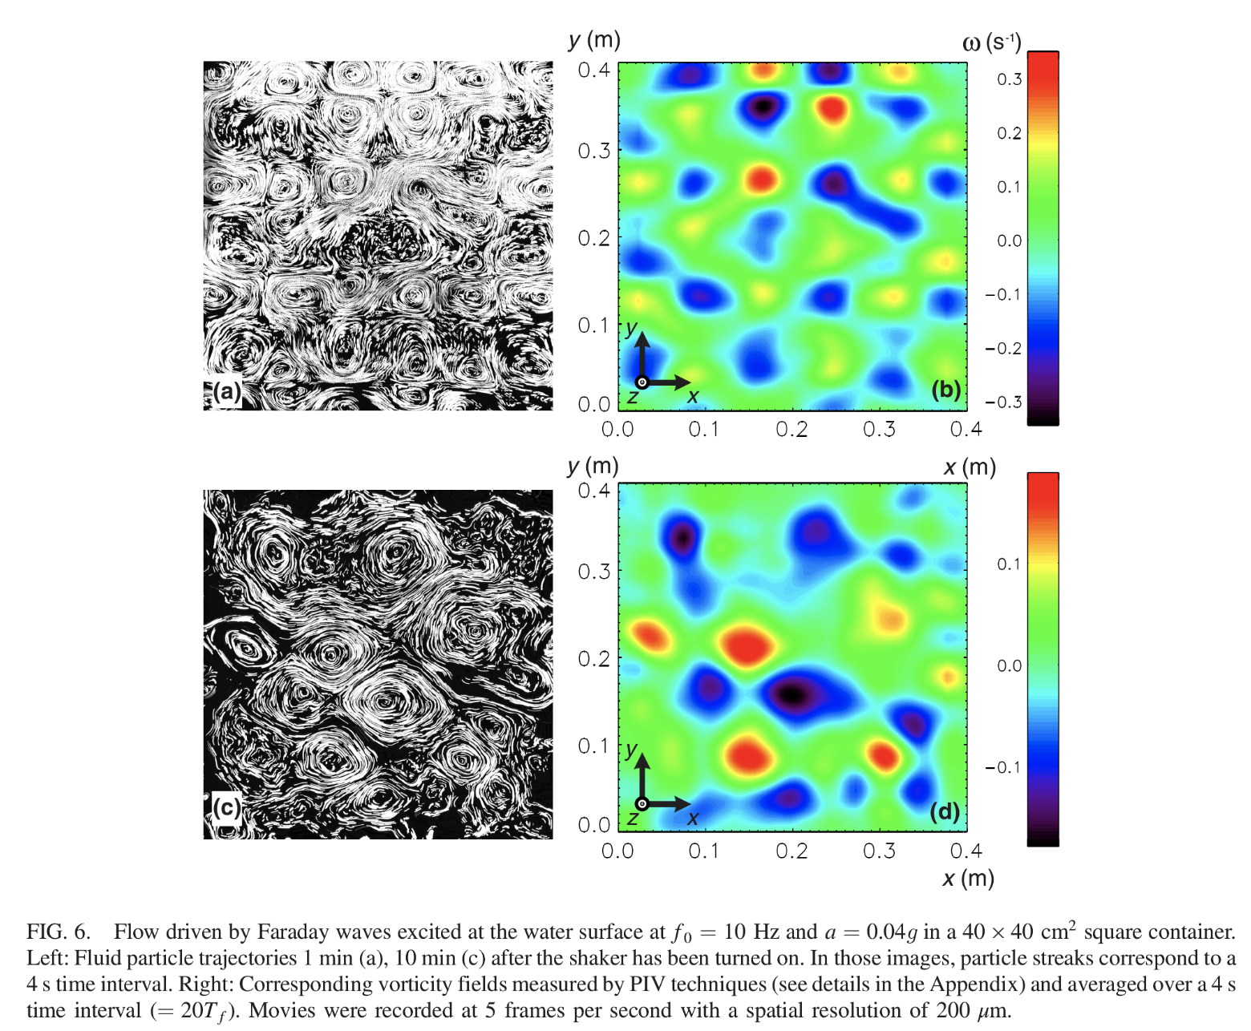
Vorticity Study
Lag. Cur.-/->Eul. Vor.
PIV techniques
prove FW generate vorticity
ultimately aggregate into large eddies
total vorticity remains 0

Slide 11
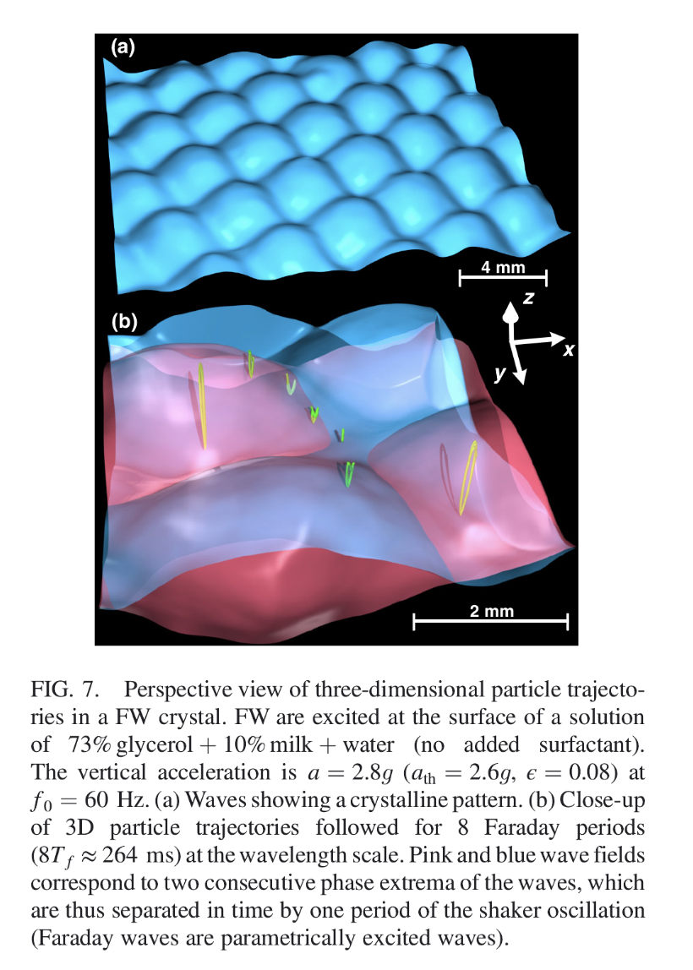
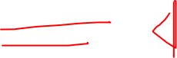
Wave Crystal
viscosity up
no flights
acceleration increase
structure breaks down
2D turbulence is the source

Slide 12
Further Problems for Us

Slide 13
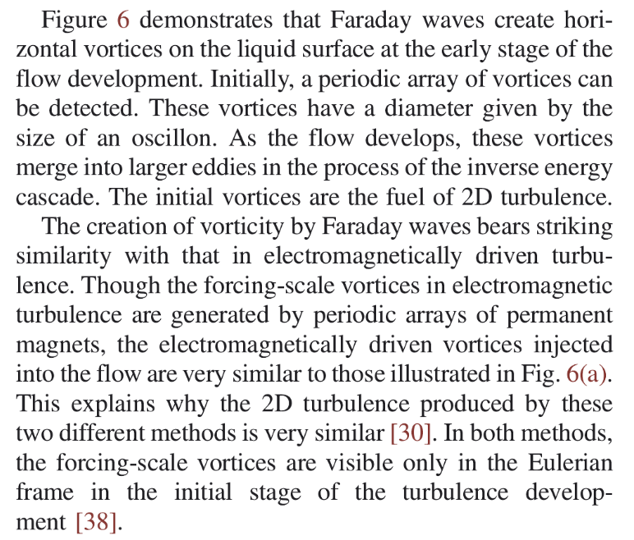
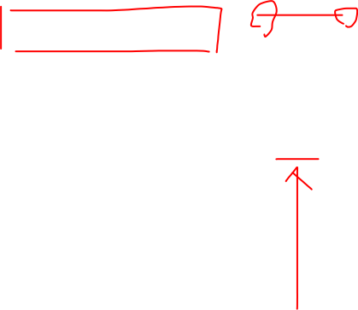
Long-lasting Tur.
in FW only at early stage
in our case it is long-lasting
contradicting I.E.C.?

Slide 14
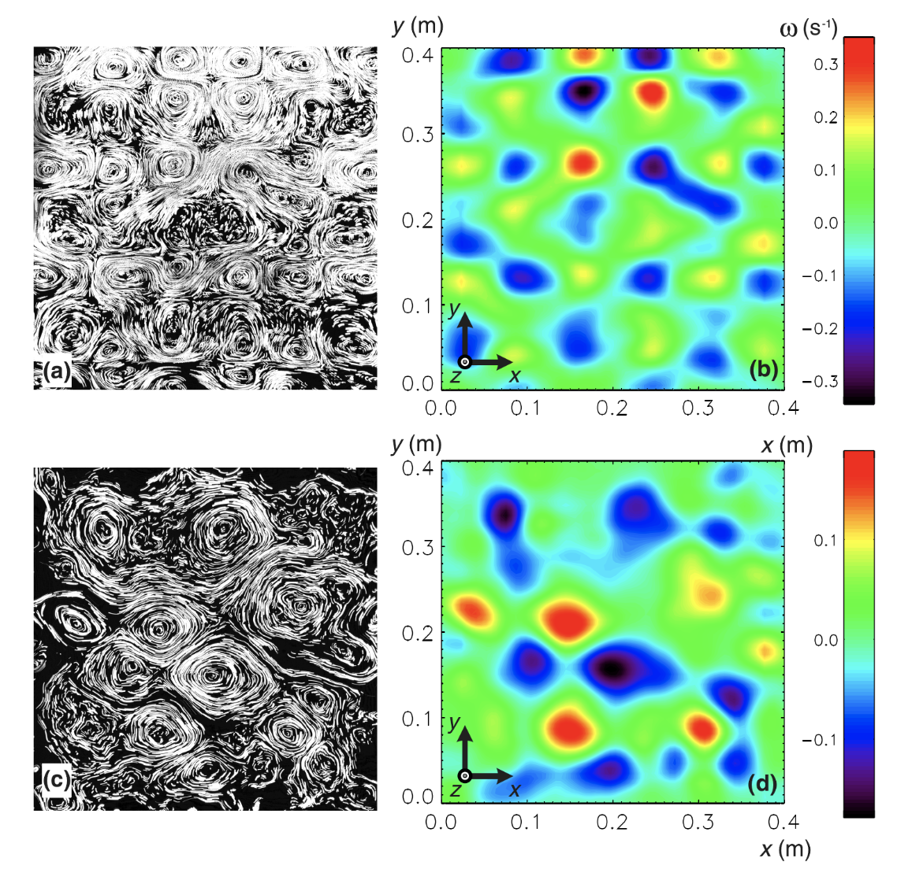
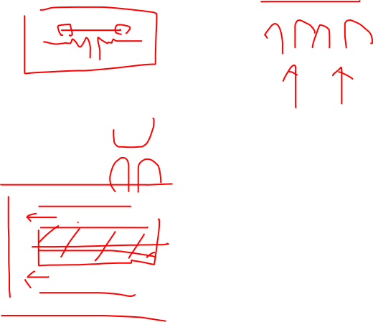
Direction of Flow
FW is somewhat homogeneous
our model is not
preferred direction for flights
this induced the tractor beam
why is that

Slide 15
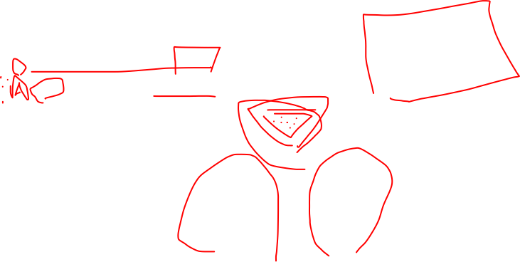
Mechanism of Tur.
PIV could prove vorticity
how it is created?
do we have a similar crystal
change in viscosity

Slide 16
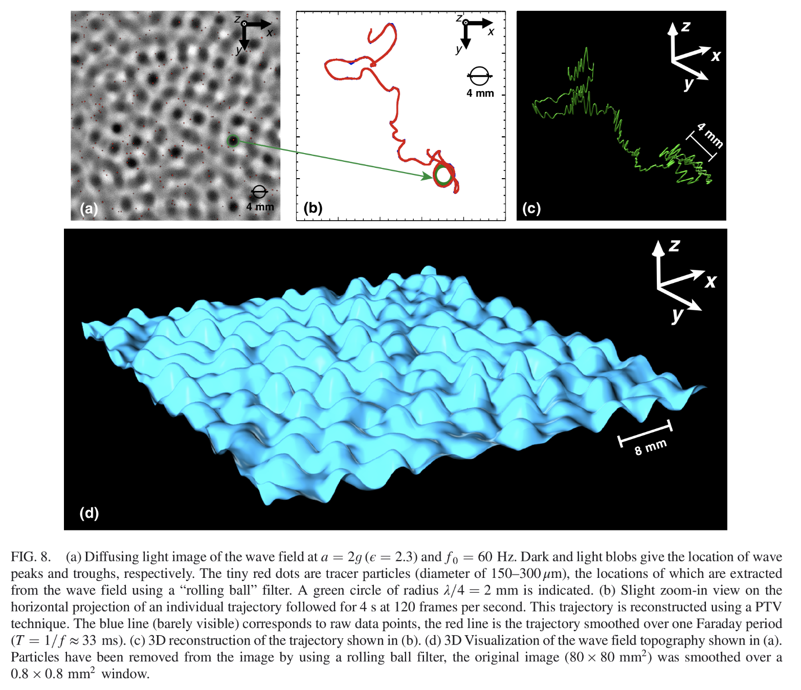
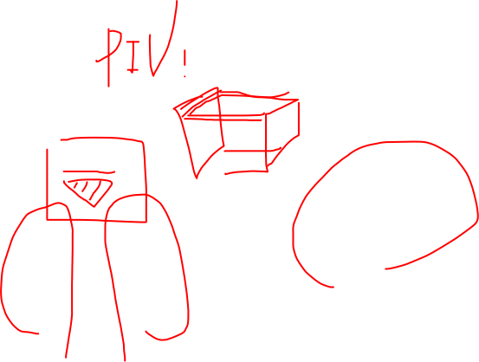
Equipment
how to do experiment

